Slide 1


Grocery Store Management Orange Stores
University of New Haven
TAGLIATELA COLLEGE OF ENGINEERING,
West Haven, CT
Team Data Dive Submitted to
Charitha Sree Jayaramireddy (cjaya1@unh.newhaven.edu ) Proff Reza Sadeghi
Madhavi Kuchipudi (mkuch2@unh.newhaven.edu) Spring 2021
Ganesh Putta (gputt1@unh.newhaven.edu) CSCI – 6622- Database systems
Pranitha Challa (pchal4@unh.newhaven.edu)
Monika Veerati (mveer3@unh.newhaven.edu)

Slide 2

Contents:
What is GSM?
ER Diagram
Tables
Database
GUI – MySQL Connection
Queries through Python
GUI
Limitations & Future Work
References

Slide 3
What is GSM?
Grocery Store Management System is designed to provide the grocery stores with the benefit of having everything online, from products data to customers data.
It helps the store managers to perform various functions like checking the products stock, suppliers information, customers information and also allows them to check if a particular product is available in any other branch.
It also helps to keep track of the store employees.
Provides a user friendly interface where everything can be accessed with just a button click.

Slide 4
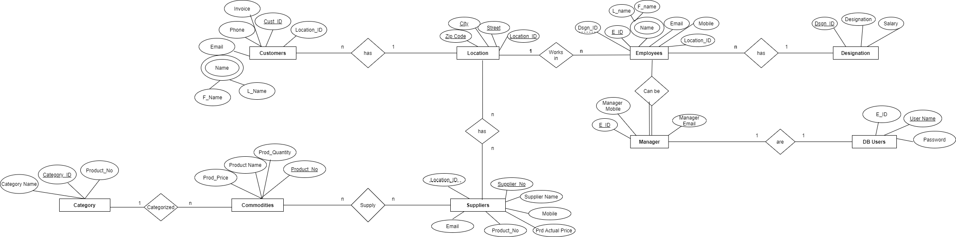
ER Diagram

Slide 5
Tables
Designation
Dsgn_ID
Designation
Salary
Location
Location_ID
Zip Code
City
Street
Employees
E_ID
Name
F_Name
L_Name
Email
Mobile
Location_ID
Dsgn_ID
Works In
Suppliers
Supplier_No
Supplier Name
Mobile
Product_No
Email
Location_ID
Prd Actual Price
Manager
Manager Mobile
Manager Email
E_ID
DB Users
E_ID
Username
Password
Customers
Cust_ID
Location_ID
Name
F_Name
L_Name
Email
Phone
Invoice
Commodities
Product_No
Product_Price
Product Name
Quantity
Supply
Category
Category_ID
Category Name
Product_No
Categorized

Slide 6
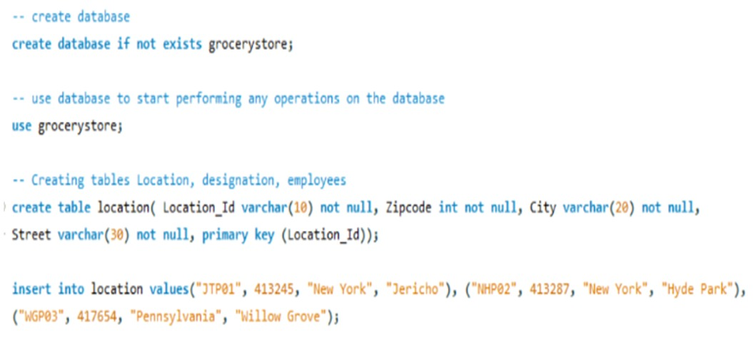
Database
We have performed various operations like -
Create, Insert, Alter
Select, Delete, Update
Used “joins” to display data from two different tables at a place.

Slide 7
Database
Created views using joins to have a virtual table which can be accessed anytime.
Created a table for login credentials which allows only the managers of the store to access the database.

Slide 8
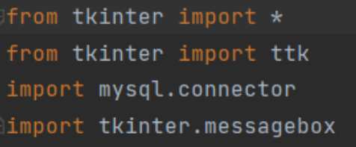
GUI – MySQL Connection

Slide 9
Queries through Python
query = "INSERT INTO location(Location_Id , Zipcode, City , Street) values(%s, %s, %s, %s) "
values = (Location_Id , Zipcode, City , Street)
mycursor.execute(query, values)
conn.commit()
sql_query = "SELECT * FROM location WHERE Street=%s"
mycursor.execute(sql_query, name)
searchResult = mycursor.fetchall()

Slide 10
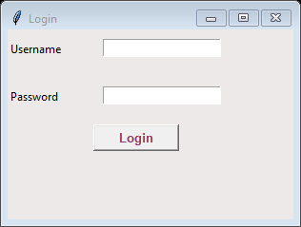
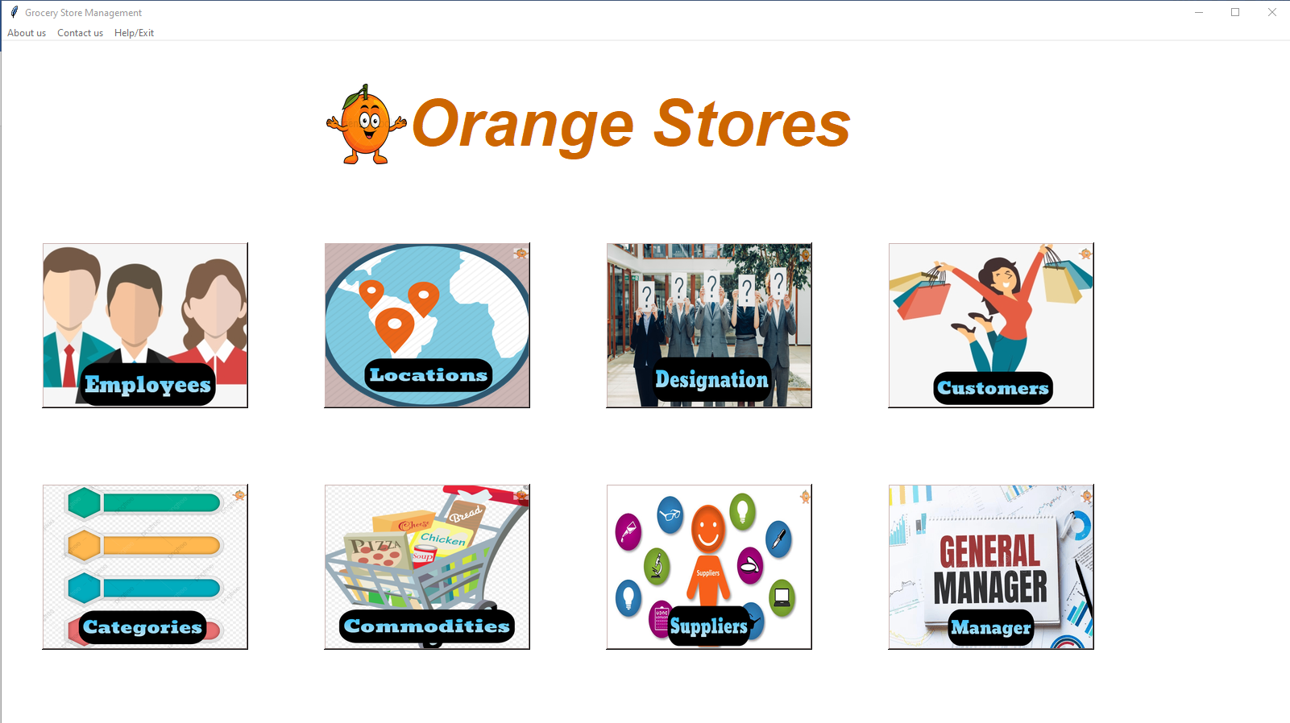
GUI

Slide 11
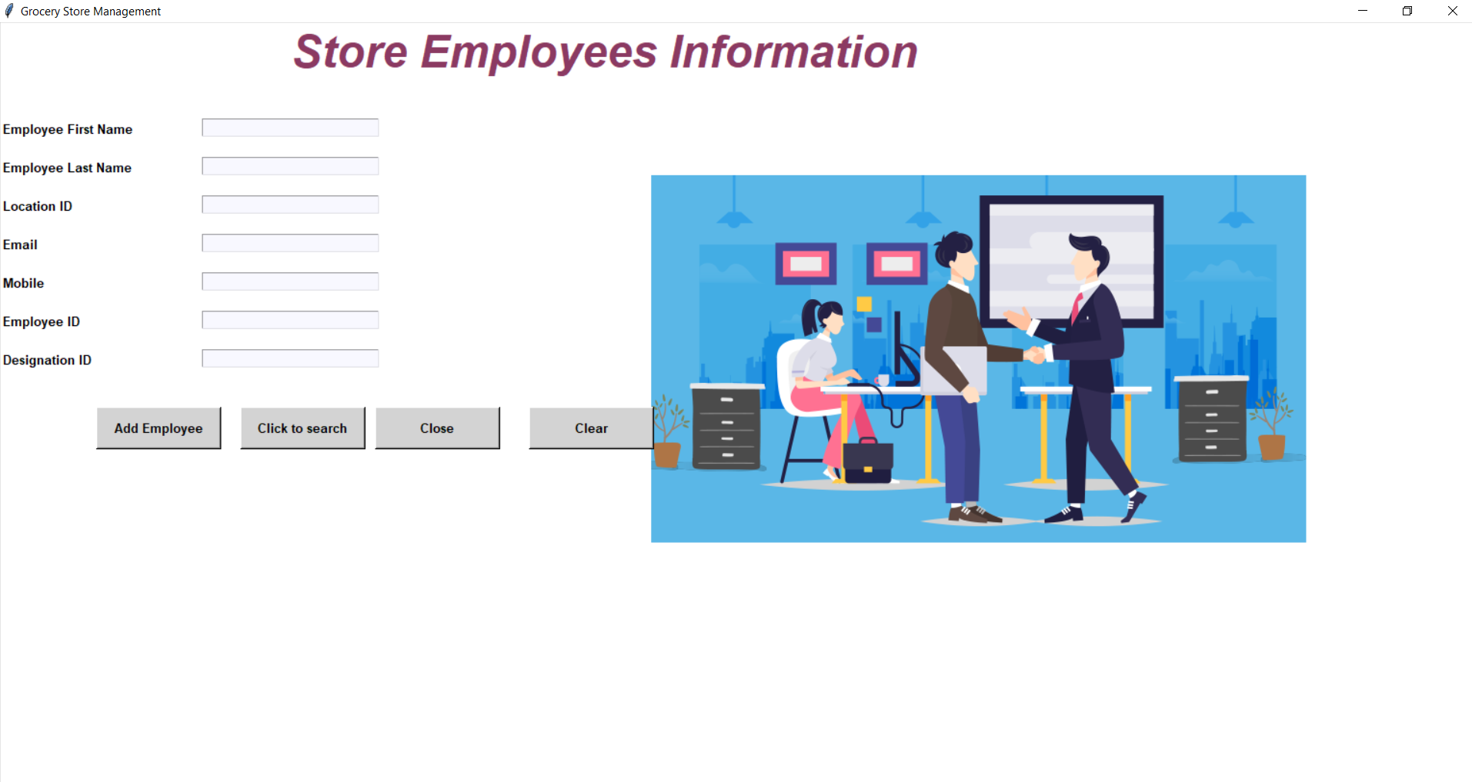
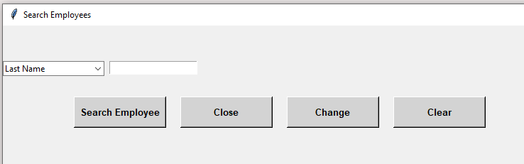

Slide 12
Limitations & Future Work
We have developed the GUI using only python Tkinter, so it is not accessible through web. We will be integrating the now python files with web in the future.
Customer login.

Slide 13
References
https://codemy.com/intro-tkinter-python-gui-apps/
https://anzeljg.github.io/rin2/book2/2405/docs/tkinter/ttk-Treeview.html
https://www.tutorialspoint.com/python/python_gui_programming.htm
https://www.w3schools.com/sql/default.asp

Slide 14

This Photo by Unknown Author is licensed under CC BY

Slide 15

Thank you

